Slide 1
Relational DBMS
Pravin Y Pawar

Slide 2
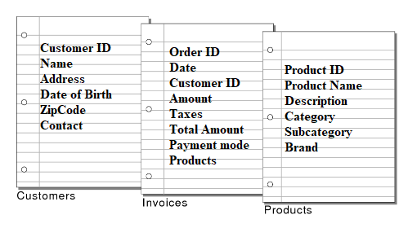
Table
Table
An arrangement of words, numbers or signs , or combinations of them
as in parallel columns,
To exhibit a set of facts or relations in a definite, compact and comprehensive form
- Webster’s Dictionary of English Language

Slide 3
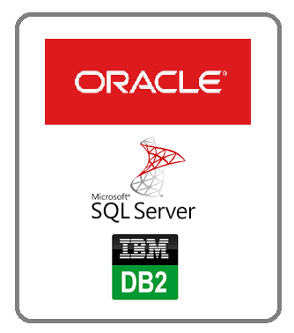
Relational DBMS
Table based
Relational model proposed by Codd in 1970
Revolutionized the database field and replaced earlier models
Hierarchical and network data models
Several vendors offering relational DBMS software
Oracle, IBM DB2, Informix, Sybase, MS Access, MS SQL Server etc.
Ubiquitous in marketplace and multibillion dollar industry!
Bases on very simple and elegant data model
Provides easy to understand use query language

Slide 4
Relational model
Relation
Based on concept of relation or table
Database is represented as collection of one or more relations
Each relation is table with rows and columns
Simple to understand for novice users as well
Structured Query Language (SQL) allows use of simple, high level language to query data
Advantage
Simple data representation
Ease with which complex queries can be written
ID | Name | Age | Marks
1 | Suresh | 21 | 34
2 | Dinesh | 22 | 21
3 | Mahesh | 21 | 45

Slide 5
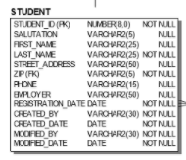
Relation
Explained
Relation is main construct of RDBMS
Consists of relation schema and relation instance
Relation schema
describes the columns of the table
Specifies the relations name, name of each field, type of each field
Relation instance
table containing the records
Set of tuples
Each tuple has same number of fields as the schema
ID | Name | Age | Marks
1 | Suresh | 21 | 34
2 | Dinesh | 22 | 21
3 | Mahesh | 21 | 45

Slide 6

SQL
Language of RDBMS
SQL is a domain-specific language used in programming and designed for managing data held in a relational database management system (RDBMS)
The scope of SQL includes
data query
data manipulation (insert, update and delete)
data definition (schema creation and modification)
data access control
SQL Consists of sublanguages
Data definition or data description language (DDL)
A syntax for creating and modifying database objects such as tables, indexes, and users
Statements are similar to a computer programming language for defining data structures, especially database schemas
Common examples of DDL statements include CREATE, ALTER, and DROP
Data manipulation language (DML)
A syntax for adding (inserting), deleting, and modifying (updating) data in a database
Statements consists of different clauses like where , group , having etc.

Slide 7
Thank You!
Reference :
Database Management Systems, by Ramakrishna
In our next session:

